Slide 1

Performance Automation Training
Abril 2017

Slide 2

Contenido
Webservices
Listeners

Slide 3

Webservices
Performance Automation Training

Slide 4

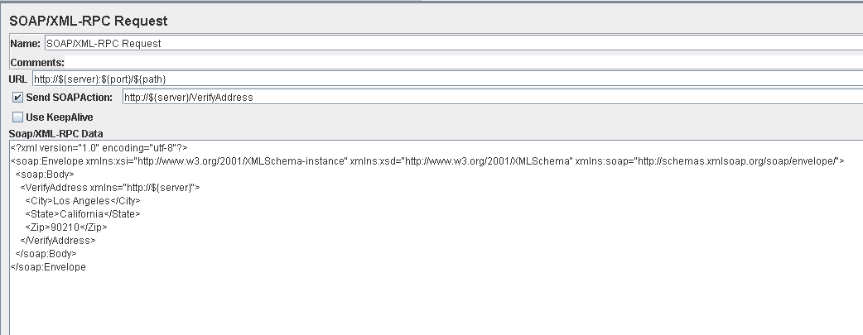
Soap/XML-RCP Request

Slide 5
Listeners
Performance Automation Training

Slide 6
Listeners
Aggregate Report
Perfmon

Slide 7
Muchas gracias por su atención

